Slide 1
Project Title: Next Best Action
Name | Roll Number | Sap-ID
Adarsh Kandwal | R103218007 | 500068043
Ritik Ranjan Tripathi | R103218118 | 500067646
Ritik Kathuria | R103218117 | 500067286
Saubhagya Marwaha | R103218131 | 500068772
Sarthak Saraiya | R103218129 | 500067734
Under the guidance of
Dr. Hitesh Kumar Sharma

Slide 2
AGENDA
Objective
What’s New?
Target Audience
Technology Used
Project Demonstration
Future Score
Conclusion

Slide 3
OBJECTICVE
Given a dataset of transactions (Online Retail dataset from UCI Machine Learning repository) get the segments i.e. clusters/segments. (Find common patterns and group them)
Understand which marketing activities are most likely to move each individual customer closer to purchase.
Predict what to display to what group of users
Using Machine Learning algorithms to find out the Next Best Action for a customer.
Categorizing the customers in a particular segment based on their buying patterns.
Predicting which kind of items they will buy in future based on their segmentation

Slide 4
WHAT’S NEW
In this project, we are making use of Logic that deals mathematically with imprecise information usually employed by humans.
As we are well aware of the fact that humans can solve In-deterministic data, while on the other hand computers can solve deterministic data.
We are employing a project that would make computers handle the in-deterministic data.
There also exist uncertainties in customer behavior while purchasing products at an retail store , the model will help to understand the customer behavior .

Slide 5
TARGET AUDIENCE
We wish to target individuals who are keen on new innovation, assisting them with deciding. It tends to be a merchant for subcontracting a task or any individual who wishes to facilitate their work with the assistance of innovation.

Slide 6
TECHNOLOGY USED
In the given project, we have used the basics of machine learning predicting Customer behavior & Buying pattern, and the language we have entirely used is python.
The software we used while working on the project is Jupyter Notebook.

Slide 7
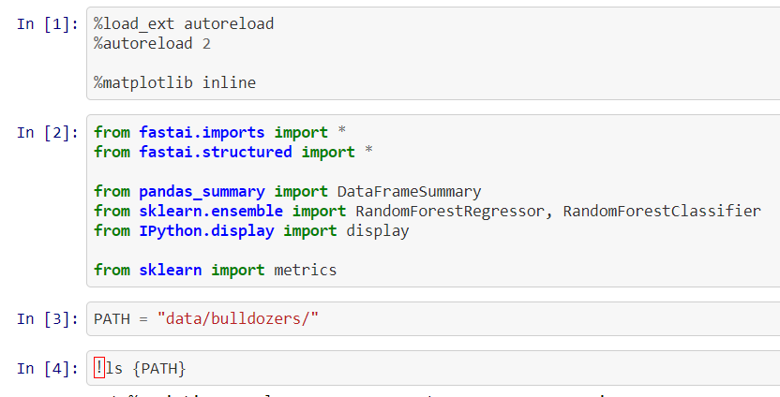
PROJECT DEMONSTRATION

Slide 8
PROJECT DEMONSTRATION

Slide 9
PROJECT DEMONSTRATION

Slide 10
PROJECT DEMONSTRATION

Slide 11
FUTURE SCOPE
We wish to smooth out the results with more accuracy than we have already.
We hope to work with many other algorithms and try-test the accuracy of each algorithm in terms of time complexity and accuracy of results.

Slide 12
CONCLUSION
While working on the project, we came across many difficulties. However, we tried our level best to tackle them in the best way possible.
We are able to categorize the customers in a particular segment based on their buying patterns.
The precision of the model is about 89.2%.

